Slide 1
Python and Turtle Module
Year 9
Lesson 1

Slide 2
Contents
Aims and Objectives of lesson
Task list and summary

Slide 3
Aims and Objectives
Admin:
In this lesson you will copy the work tracker spreadsheet to your folder and learn how to use it
Academic:
In this lesson you will be finding out about Python and how to work with it.
You will be writing your first script, saving it and running it

Slide 4
Task List
Setup work tracker
Activity on magic of technology
Discussion on how this technology is created focusing on software
Demonstration and activity on how Python works using a simple script
Video and demo of how to load Python and write your first script
Pupils work through their first script, save it and test it

Slide 5
Work tracker
Each unit of work has a work tracker which you need to download and put in your personal work space
Create a folder called ‘9 Computing’ and another folder inside that called ‘Python Turtle’
The worksheet tracker is called ‘9_pythonturtle_tracker.xls’ and is on the K: drive
Copy and paste that into the the folder you have just created

Slide 6
Work Tracker
The work tracker has two sheets
A front page with summary information
Add your name
A second page for tracking what you are doing
A list of the work you must complete for the unit
The location of the work for handing in at the end of the unit
A status for you to change to say what stage you are up to

Slide 7
The Magic of Technology
In 5 minutes create a slide-deck using the title ‘The Magic of Technology’
I would like you to include examples of the best technology you have used or want to use
Remember that technology is not just hardware it is also software so think about interesting software as well

Slide 8
How is this technology created?
Let’s focus on the software side
Questions:
Who makes software?
How is software made?
If it’s a graphical game such as Plants vs Zombies does the game just consist of graphics?
Therefore how do the characters move?

Slide 9
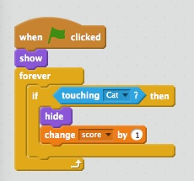
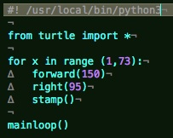
Text-based programming
All software which you use is created by a software developer writing instructions (algorithms) in a text based programming language
Text-based programming
Block programming

Slide 10
Activity 1
Let’s take a look at text-based programming through using Python
Load Python IDLE and work with the first basic scripts
There is a video on how to load Python IDLE and begin writing in basic instructions

Slide 11
Activity 2
The previous instructions you were working with were single line instructions that didn’t do much
Next activity uses a script which asks someone a question and produces a response
Follow the instructions in the video to create the script (don’t forget to save it)
Take a look at the commenting video as well

Slide 12
Extension
If you have finished the script from Activity 2 early see if you can extend it using extra inputs and print statements
Again – don’t forget to save it!

